Slide 1

DRP 2025
Project by Charles-Étienne Lessard
mentored by Miguel Ayala

Slide 2
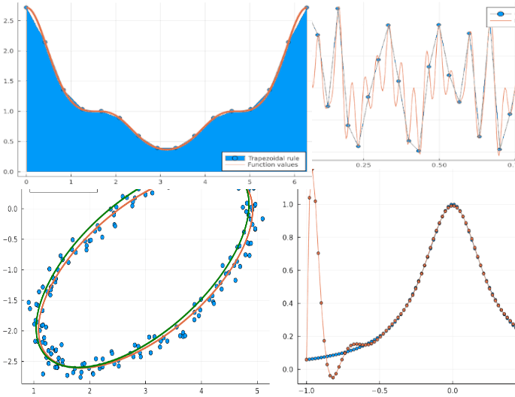
Computationnal Mathematics: Another way of exploring math
Approximate solutions to non-analytical problem
Visualization tools and intuition
Efficiency
Modelling and prediction

Slide 3
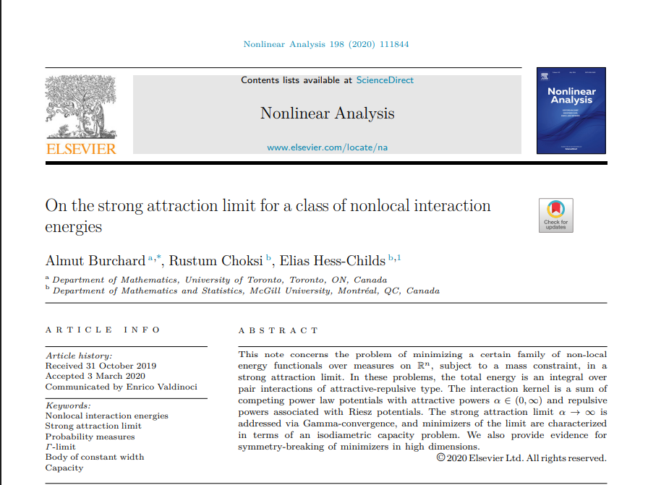
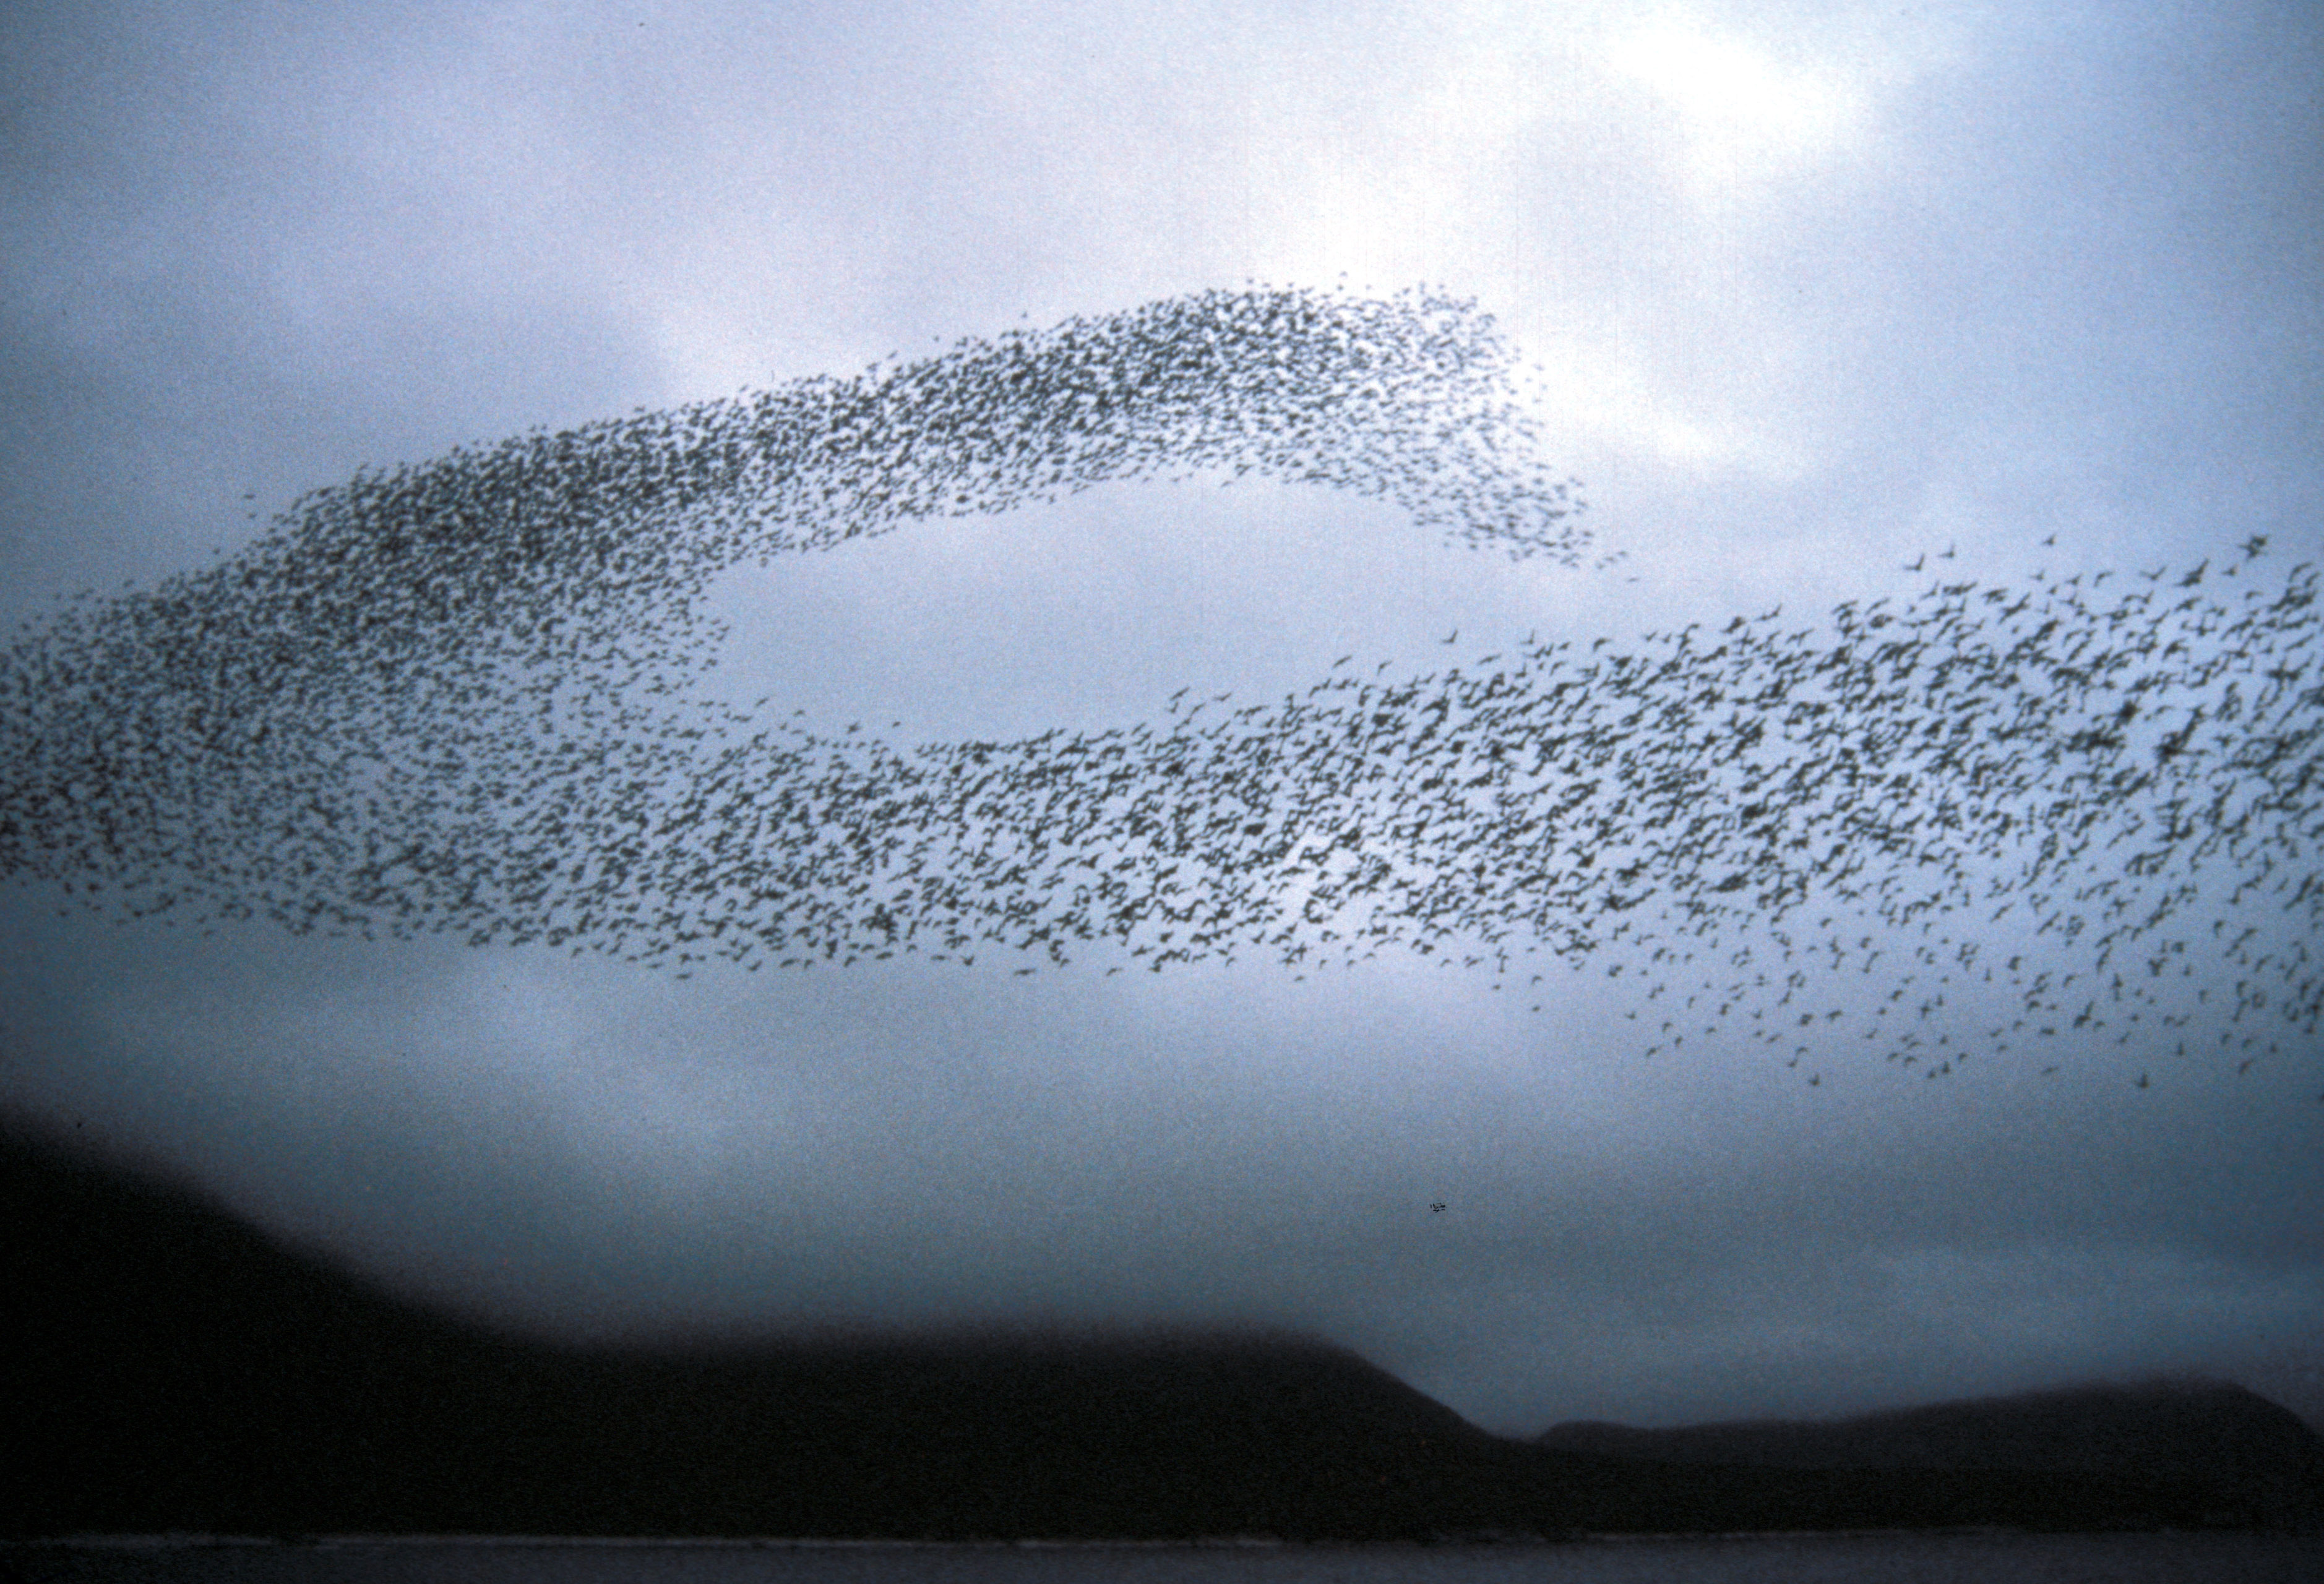
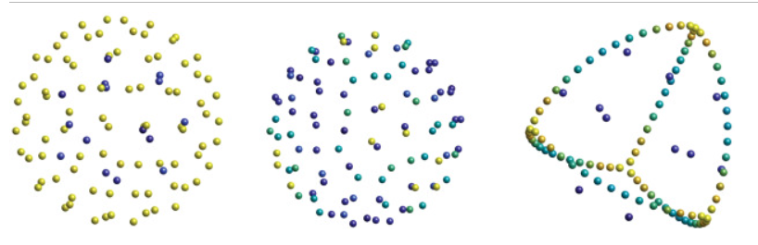
https://www.sciencedirect.com/science/article/pii/S0362546X20301036
System of Ordinary differential equations: Finding the minimizers

Slide 4
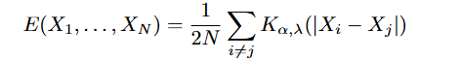
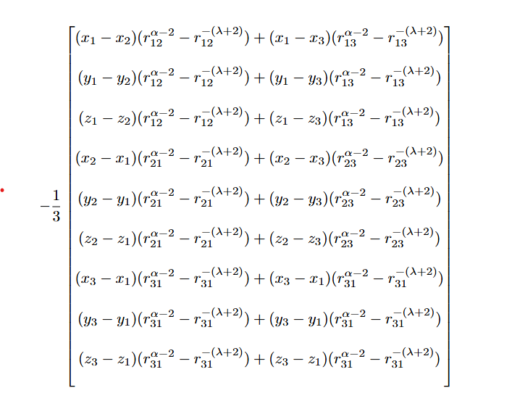
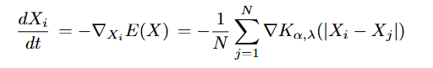
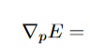
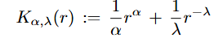
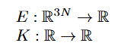
System of ODE’s: Finding the minimizers
Energy Function:
System of 9 ODE’s for 3 particles
Gradient of Energy Function:
Interaction Kernel

Slide 5
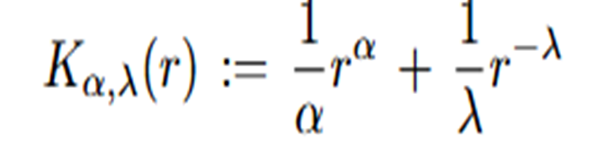

Exploration: Modelling of minimizers
Interaction Kernel
How does the variation of the parameters affect the behaviour of the minimizers?
Which quantitative measurements can we take on the steady states?
Does the number of particles have an influence on the behaviour of the steady states?

Slide 6
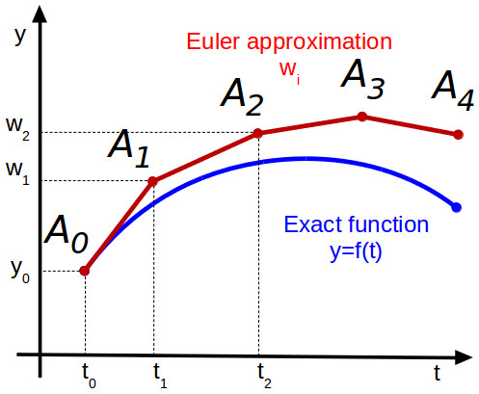
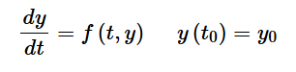
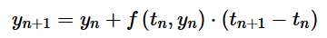
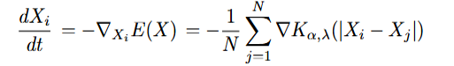
How does a solver work? (Euler Forward Method)
Apply the numerical algorithm on each equation of the system :

Slide 7
1.How does the variation of the parameters affect the behaviour of the minimizers?
Put pluto demo

Slide 8
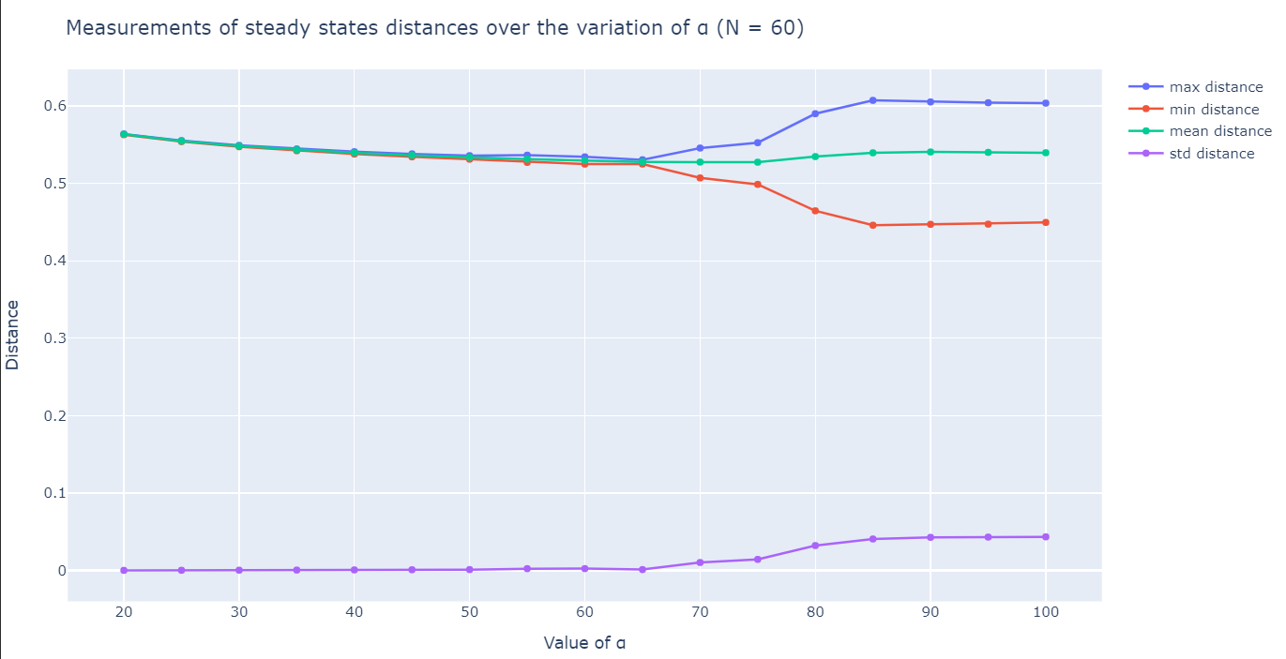
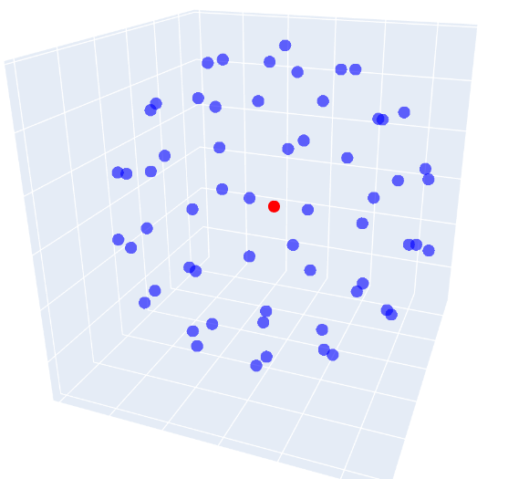
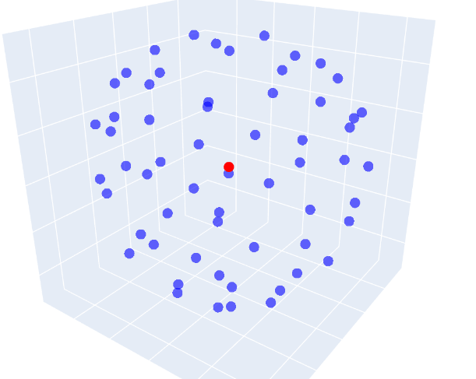
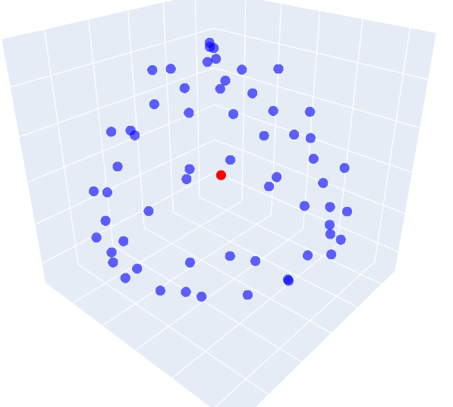
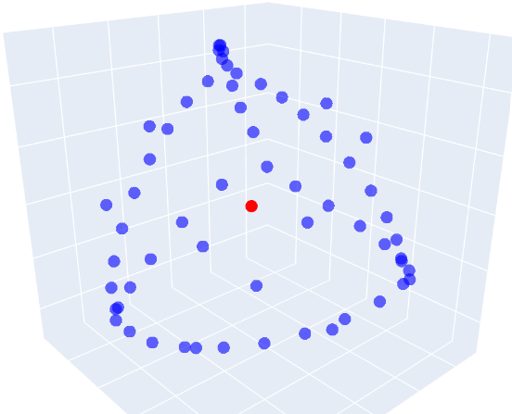
2. Which quantitative measurements can we take on the steady states?
α = 20
α = 75
α = 80
α = 100

Slide 9
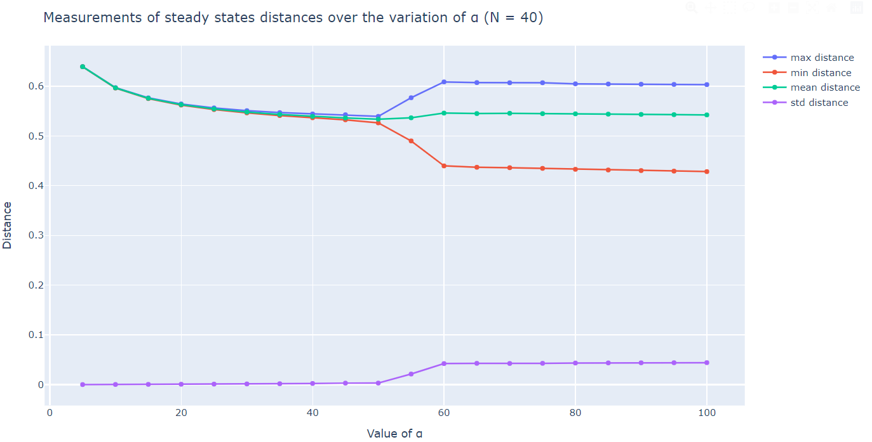
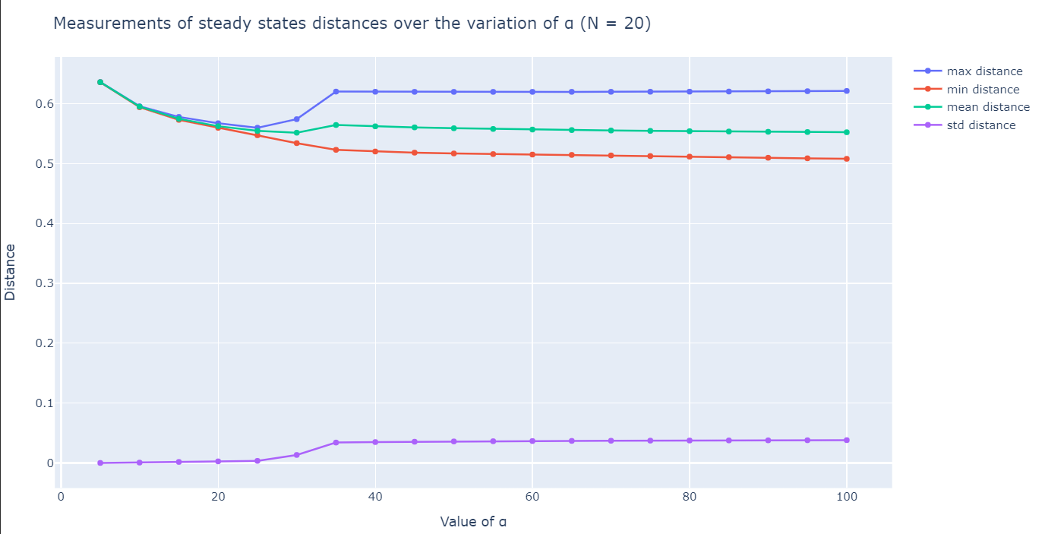
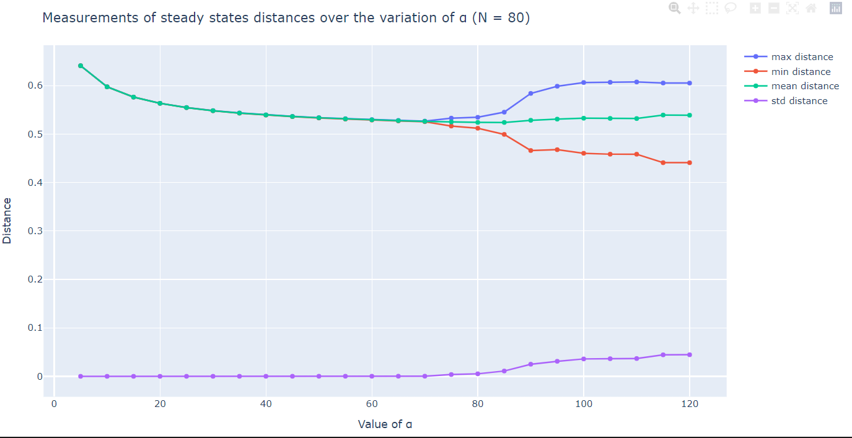
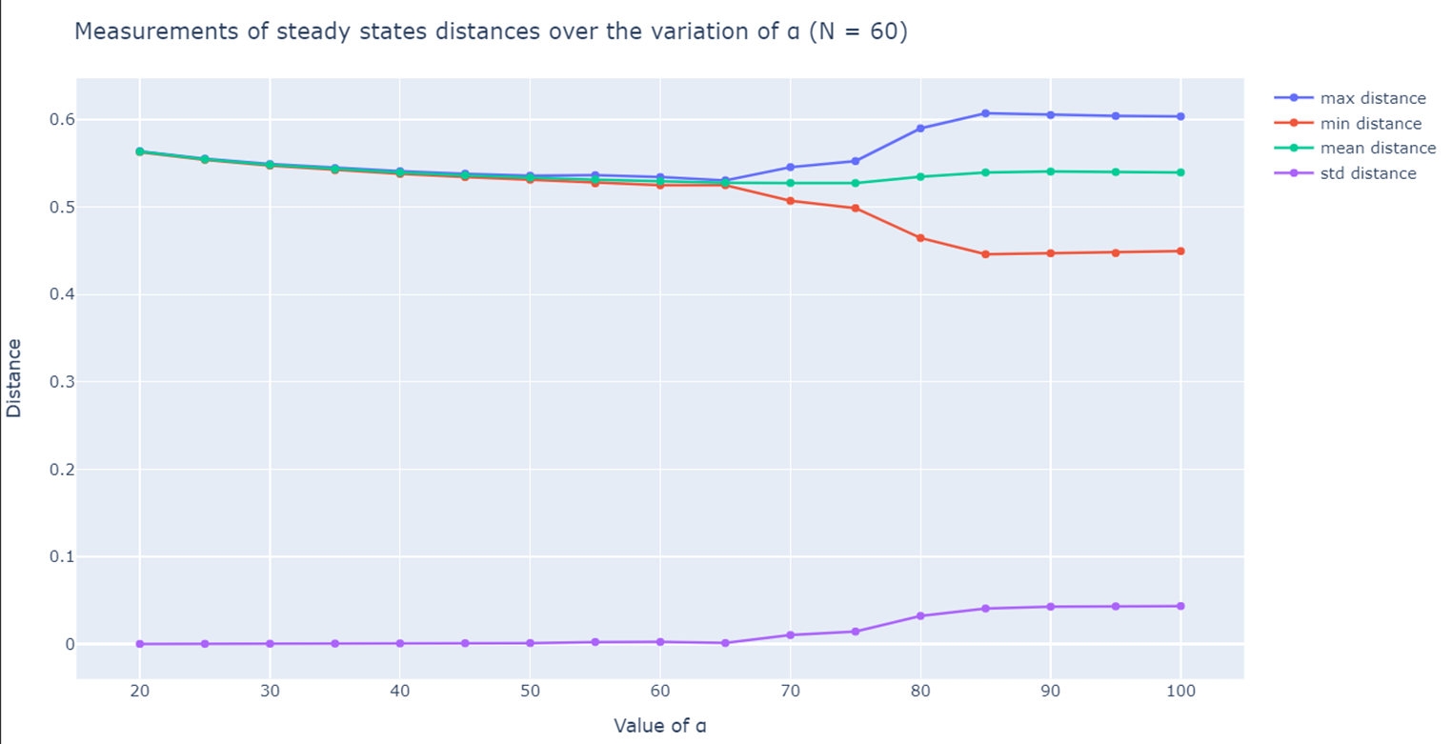
3. Does the number of particles have an influence on the behaviour of the Minimizers?

Slide 10
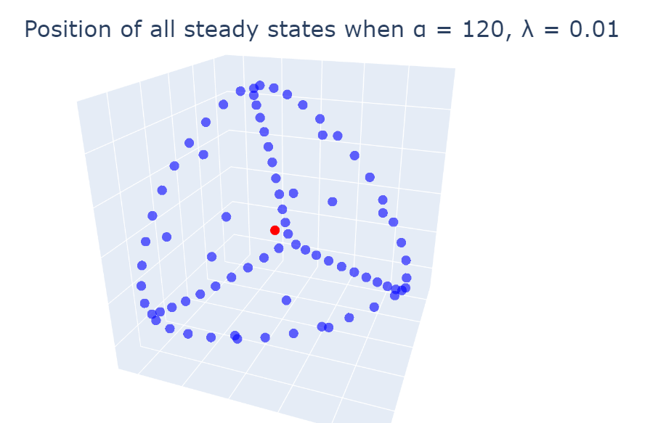
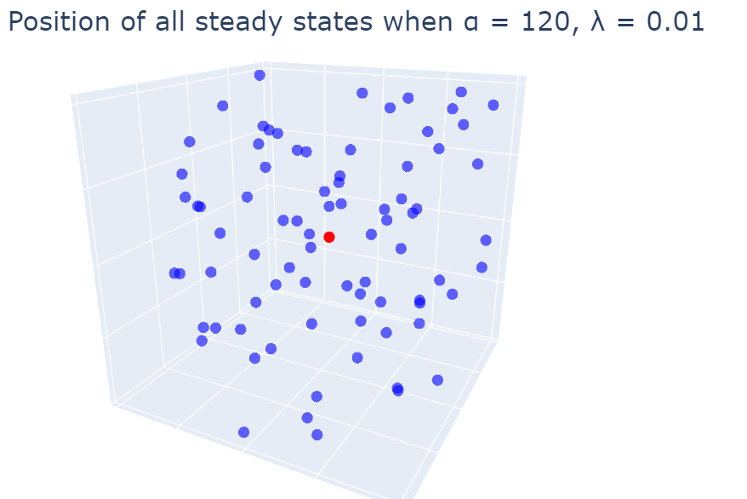
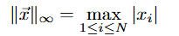
Precision of the numerical solutions
Norm = 6.34 x 10⁻⁷
Norm = 6.41 x 10⁴⁹

Slide 11

Further exploration: Other questions
How does the parameter lamba affect the behaviour of the minimizers?
Up to which precision can we predict the symetry break for given parameters?
Do different initial conditions affect the results?
Does using a different solver affect the results?

Slide 12
Bibliography

